Slide 1
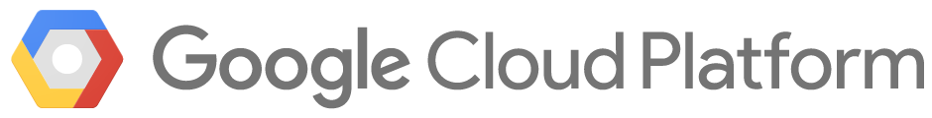

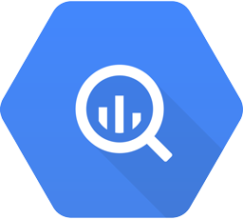
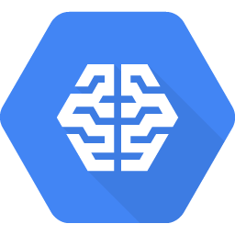
Project
Full data cycle on cloud
1 Run queries on public datasets
Data Exploration Colab
2 Explore/Visualize public datasets
BigQuery (SQL)
3 Predict using Machine Learning
Cloud Machine Learning
Notes:
Now onto the project. You’ll run through a full data cycle of what a typical data system or scientist does. We’ll use Google’s cloud and BigQuery for the project. After this course, you’ll be comfortable running through a real data cycle in AWS or Azure. It’s easy to go cloud hopping with same underlying concepts.
1. You’ll run queries on Google’s cloud BigQuery. GCP host several public datasets including NY Taxicab pickup/dropoffs, NCAA basketball stats, weather/hurricane data, pollution data to Bitcoin/ETH datasets. The first project is for you to run SQL queries on some datasets.
2. Next we’ll offer some datasets. You’ll go deeper into the data, visualize and explore the BigQuery data in Colab/Jupyter -- a popular python based package to explore data
3. Finally, the big 20% project will involve some learning on datasets and tying together the concepts in a full data cycle. We’ll roll out specifics in the upcoming weeks.

Slide 2
Public datasets: [q = “BigQuery public dataset”]
Explore public datasets (NCAA, Weather, Hurricanes, Blockchain…)
Let’s pick [Bay Area Bikeshare]
[ Schema ]

